Slide 1
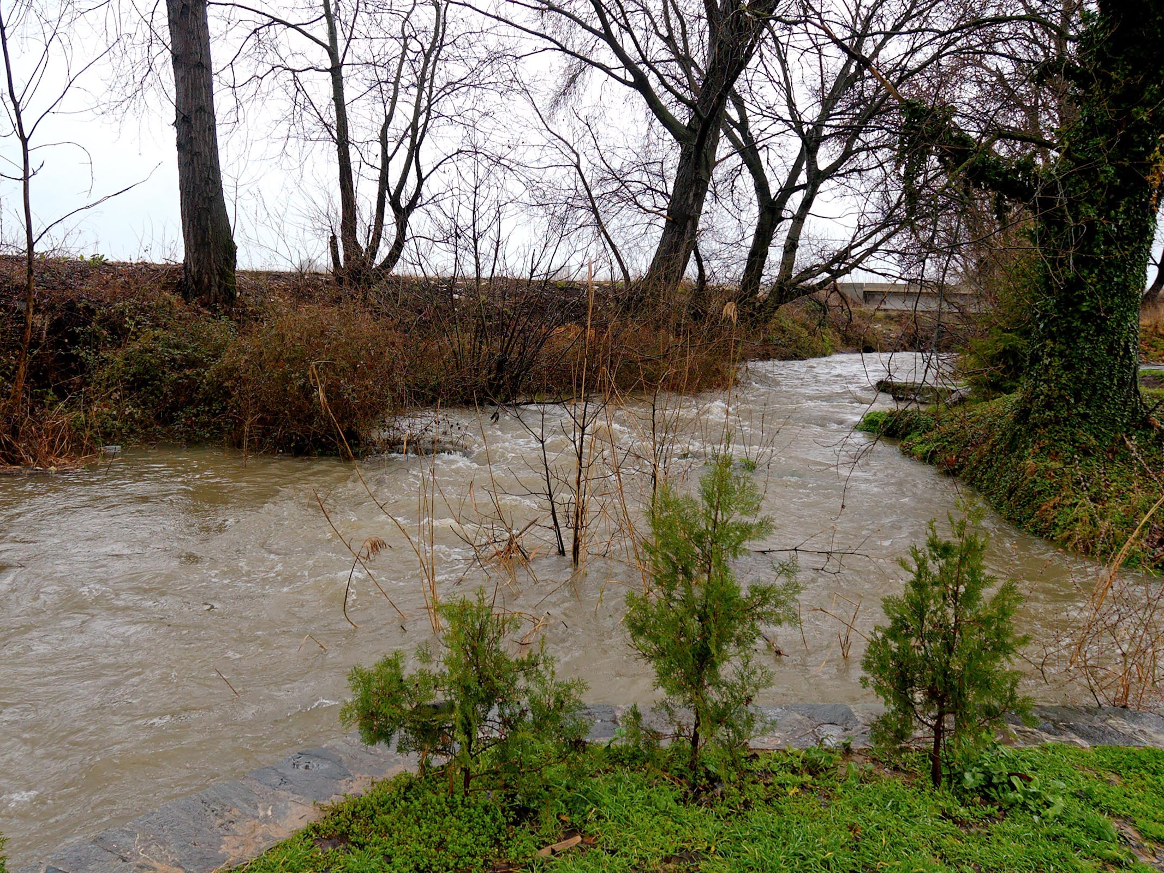
Likely spot of where Paul and Timothy began evangelizing to found the church in Philippi.
image © 2012 Todd Bolen / BiblePlaces.com

Slide 2
Philippians 4.13 NET: I am able to do all things through the one who strengthens me.

Slide 3
Philippians 4.6-7 NET: Do not be anxious about anything. Instead, in every situation, through prayer and petition with thanksgiving, tell your requests to God. And the peace of God that surpasses all understanding will guard your hearts and minds in Christ Jesus.

Slide 4
continue working out your salvation [2.12]
be of the same mind [2.2]
live in a manner worthy of the gospel of Christ [1.27]
Rejoice in the Lord always [4.4]
live up to the standard we have already attained [3.16]

Slide 5
Philippians 2.6-8 NET: [Christ] who though he existed in the form of God did not regard equality with God as something to be grasped, but emptied himself by taking on the form of a slave, by looking like other men, and by sharing in human nature. He humbled himself, by becoming obedient to the point of death– even death on a cross!

Slide 6
Philippians verse by verse!
image © 2012 Todd Bolen / BiblePlaces.com

Slide 7
Philippians 1.1 NET: From Paul and Timothy, slaves of Christ Jesus, to all the saints in Christ Jesus who are in Philippi, with the overseers and deacons.
WHY?

Slide 8
Antagonists
Author
uses
uses
poor theology
fr. poor sources
to pressure
to exhort
good theology
fr. good sources
Readers
to act in the flesh
to act on revelation
bottom-line commands
top-line commands

Slide 9
Author
Paul and Timothy
Readers
Believers in Philippian church

Slide 10
Paul and Timothy [1.1]
Paul: an apostle [1.16]
 once a Pharisee persecuting the church [3.5-6]
 mistreated for the gospel in Philippi [1.30]
 in Roman prison for the gospel [1.7, 13-14, 17; 4.22]
 content b/c doing ministry there! [1.12-14; 4.11-13]
Both: consider themselves slaves for Christ [1.1]
 gave up everything for Christ [2.22; 3.7-8]
 walking by faith despite hardships from gospel mission [1.18-20; 2.16-17; 3.12-14]
Author

Slide 11
Believers in Philippian church
 know authors as church founders [1.3; 2.12, 16]
 beloved by authors [1.3-9, 25-26; 2.22-24]
 responded to gospel with faithful obedience [2.12]
 defend and confirm true gospel [1.5-7]
 supported Paul as missionary [1.7; 2.25; 4.10-18]
 experiencing suffering and persecution [1.29-30]
Readers

Slide 12
Antagonists
Pagan Gentiles: persecuting believers [1.29-30]
Legalistic Jews: opposing true gospel [1.28; 3.19]
 not true believers in Christ [1.28; 3.2, 18-19]
 seeking righteousness from Law [3.2-9]
 fleshly in faith and lifestyle [3.2-3, 19]

Slide 13
top-line commands
Toward Fellow Believers
Humble Servanthood:
 regard others as more important than self [2.3]
 look out for interests of others [2.4]
 follow Christ into obedient service [2.5-8]
Unity:
 work in unity for gospel mission [1.27; 2.2]
 show forbearance [4.5]
 do not grumble or dispute [2.14]

Slide 14
top-line commands
Toward Fellow Believers
Humble Servanthood:
 regard others as more important than self [2.3]
 look out for interests of others [2.4]
 follow Christ into obedient service [2.5-8]
Unity:
 work in unity for gospel mission [2.27; 2.2]
 show forbearance [4.5]
 do not grumble or dispute [2.14]

Slide 15
bottom-line commands
Each other: argue amongst themselves [2.14]
be selfish, prideful; look to own interests [2.3-4]
Antagonists: be intimidated by them [1.28]
Selves: be anxious [4.6]
Paul: oppose his gospel [3.18]

Slide 16
bad theology
fr. bad sources
 righteousness earned by obedience [3.2-13]
 life is about worldly success [3.2, 19]
 Paul’s imprisonment is shameful [1.12, 20]

Slide 17
good theology
fr. good sources
 righteousness accounted to us by God, by grace through faith in Christ [1.1, 9-11; 3.7-11]
 deliverance does not preclude suffering; suffering might be in God’s plan [1.12-14]
 Christ was a humble and obedient servant to the point of death for the gospel mission [2.6-8]

Slide 18
good theology
fr. good sources
 Old Testament [2.10]
 Christ’s gospel [1.5, 7, 12, 16, 27; 2.22; 3.9-11; 4.3, 15]
 apostolic authority [1.16]
bad theology
fr. bad sources
 flesh [2.3-4, 14-15; 3.2-3, 19]
 Mosaic Law [3.2-4, 9];
 evil or sin [2.14-15; 3.2, 18-19]

Slide 19
Antagonists:
unsaved, fleshly, legalistic [Jewish]
Background: The Philippians faced Gentile persecution and their mentor, Paul, was in prison. The antagonists were pressuring them to see this suffering as evidence of God’s displeasure because they were not following the Mosaic Law. Some in the church began to doubt their course of following Paul and of supporting and living by his gospel, which created disunity in the church. Paul wrote to correct their theological errors and point the way to righteous living.
Author: Paul & Timothy; slaves of Christ; Paul ministering in prison
uses
to pressure
Reader: Believers in Philippi; know Authors; supportive of Paul and gospel
to exhort
uses
Poor Theology:
Good Theology:
Self righteousness derived from the Law
Deliverance is physical and present
Suffering is evidence of a curse
Imputed righteousness by grace
Sanctification a cooperative work of grace
Deliverance is to know and live for Christ
Suffering is a part of Christian life
Christ is our example
to act in the flesh,
using
to act on revelation,
using
Toward
Self
Toward
God
Antagonist’s Commands:
Be anxious!
Oppose Paul’s gospel.
Grumble and dispute; selfishly and pridefully look out for own interests.
Be intimidated by antagonists.
Inference: oppose Paul and his kind, and his gospel.
Author’s Commands:
Rejoice!
Believe, defend, and live up to the gospel.
Work in unity for the gospel mission; humbly care for teammates.
Beware of antagonists.
Follow and serve good leaders; share the gospel with non-believers.
Toward
Believers
Toward
Antagonist
Toward
Others

Slide 20
External Problem: Because Paul founded their church and led many of them to Christ, the Philippians had supported Paul and partnered with him in the gospel mission. Now, they were suffering persecution and Paul was in prison; they were experiencing pressure from local pagan Gentiles to abandon the Christian way of life, and pressure from Jews with a different gospel to see suffering as evidence of God’s curse because they were not living by the Jewish Law.

Slide 21
Internal Problem: These pressures were causing rifts within the church. People started to wonder if God was angry at them, judging them for having false theology. They saw Paul’s suffering as possible evidence that God was judging him too. Some of them began to doubt Paul’s message of imputed righteousness and to consider the message of the Jewish legalists that righteousness was earned through obedience to the Law of Israel. Thus some of them questioned whether they could continue supporting Paul.

Slide 22
Paul’s Response: Paul wrote to counter the influence of both groups of antagonists. He said the Judaizing antagonists preached a false gospel out of a false theology that is fleshly, evil, and legalistic. The Philippians should be aware of what they say, but not intimidated by them. Instead, they should continue to hold fast to the true gospel, seek to live up to the righteousness they have been granted, and continue to encourage others to embrace Christ’s gospel.

Slide 23
Key Theology: Paul says true deliverance is through the gospel: deliverance from death, sin, and judgment, and deliverance into life, intimacy with Christ, and grace righteousness with growing experiential righteousness. He encouraged them to see that suffering did not negate their deliverance and they could rejoice in this deliverance regardless of their present suffering.

Slide 24
Likely spot of where Paul and Timothy began evangelizing to found the church in Philippi.
image © 2012 Todd Bolen / BiblePlaces.com

